Slide 1
Simulating Trees with Fractals and L-Systems

Slide 2

Background - Fractals
Fractals are recursive, self-similar structures
  Infinitely detailed – zooming in reveals more detail
  Similar, though not necessarily identical, at any level of magnification
  Generated using a variety of methods, such as L-Systems
Many natural forms display fractal geometry (like trees!)

Slide 3
Background – L-Systems
Formal grammar developed by Aristid Lindenmayer as a theoretical framework for studying development of simple multicellular organisms
Subsequently applied to investigate higher plants
Uses rewriting rules (productions) to grow a string or system
Productions are applied in parallel (unlike Chomsky grammars)
  This is motivated by biological considerations – this is how living organisms grow

Slide 4
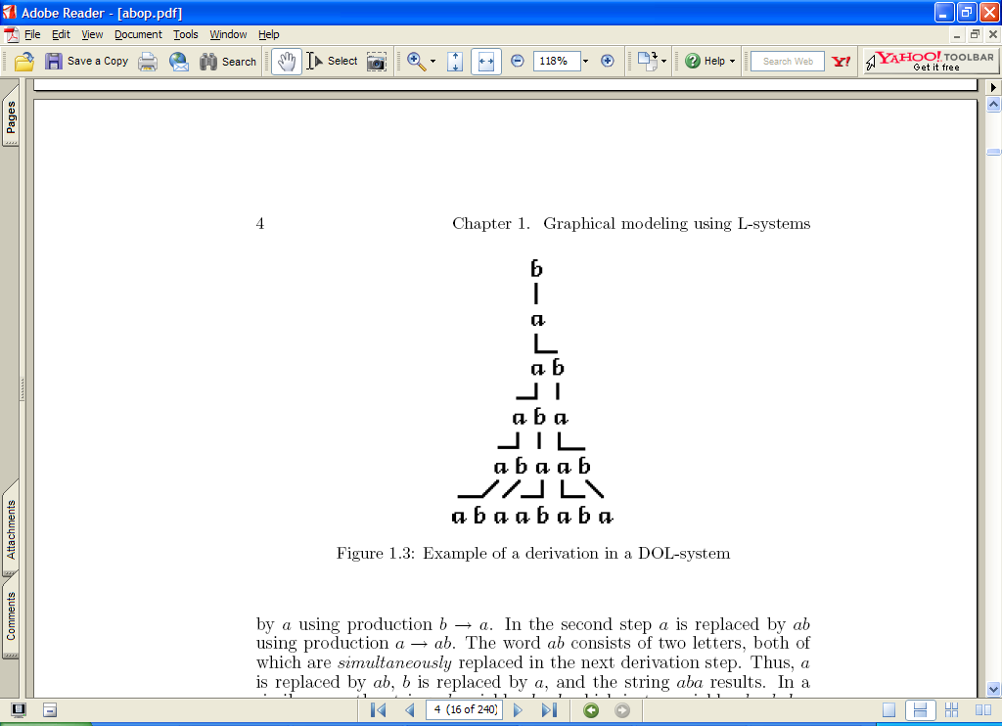
Simple L-System
Strings built of letters a and b
Each letter is associated with a rewriting/production rule:
  a → ab
  b → a
Rewriting starts from an axiom, a starting string (b in this case)
Each production is applied simultaneously in each step

Slide 5
L-Systems – Properties
Can be context-free or context-sensitive
  Different production rules for the same symbol based upon neighboring symbols
If run repeatedly and interpreted as images, can produce fractal geometry
  Can describe many “traditional” fractal patterns, such as Koch curves and constructions
  Can describe & produce very complex fractal patterns

Slide 6
Describing Trees
A rooted tree has edges that are directed and labeled
Edge sequences form paths from a distinguished node, called the root or base, to terminal nodes
  In biological sense, these edges are branch segments
  A segment followed by at least one more segment in some path is called an internode
  A terminal segment (with no succeeding edges) is called an apex

Slide 7
Axial Trees
Special type of rooted tree
At each node, at most one outgoing straight segment is distinguished
All remaining edges are called lateral or side segments.
A sequence of segments is called an axis if:
  the first segment in the sequence originates at the root of the tree or as a lateral segment at some node
  each subsequent segment is a straight segment
  the last segment is not followed by any straight segment in the tree.
Together with all its descendants, an axis constitutes a branch. A branch is itself an axial (sub)tree.

Slide 8
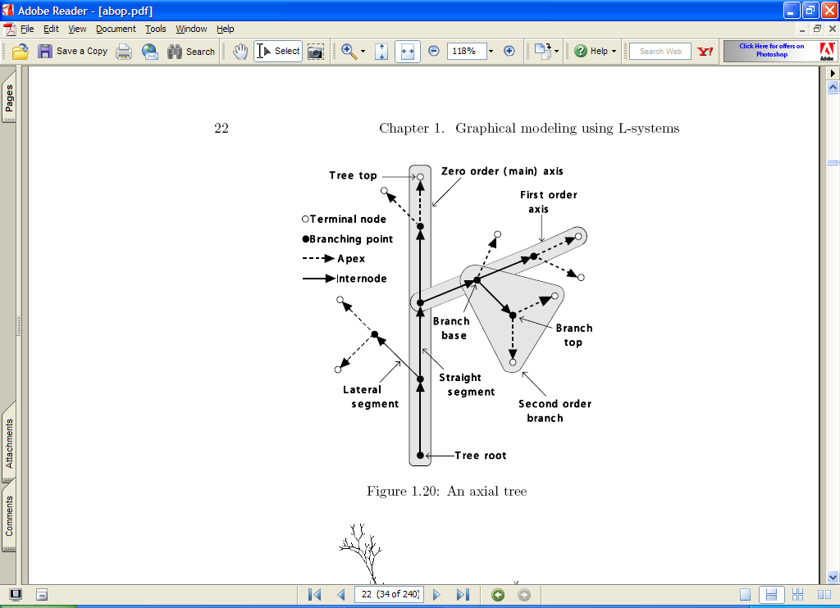
Axial Trees
Axes and branches are ordered
  The root axis (trunk) has order zero.
  Axis originating as a lateral segment of an n-order parent axis has order n+1.
  The order of a branch is equal to the order of its lowest-order or main axis

Slide 9
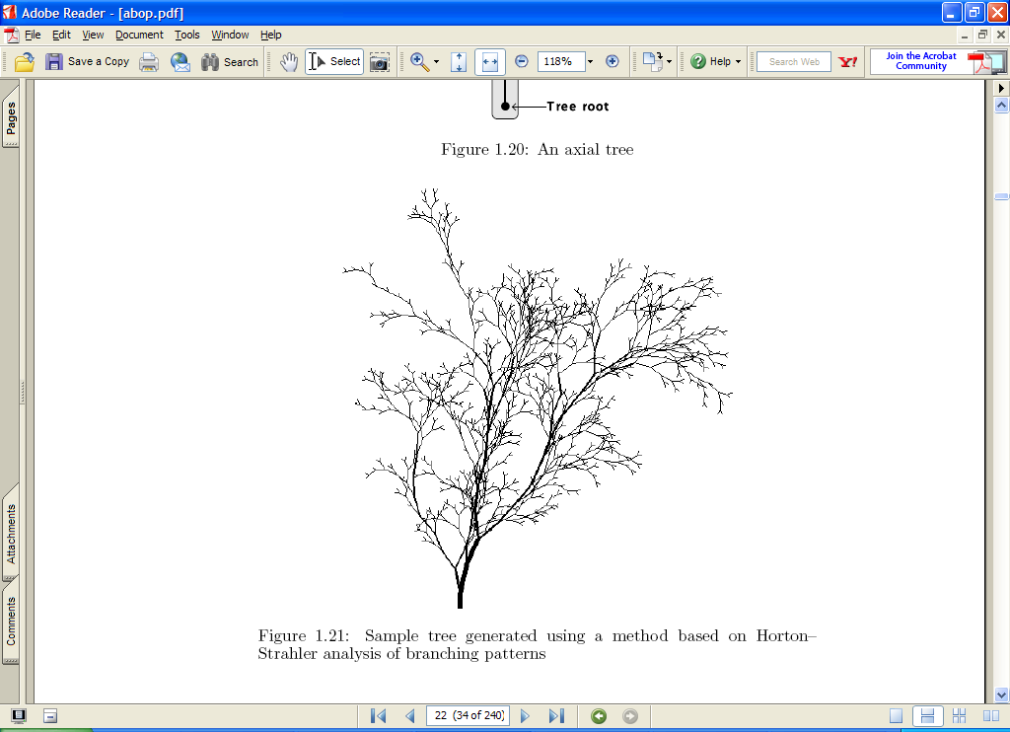
Example Axial Tree

Slide 10
Honda’s Model
Limited model with following assumptions:
  Tree segments are straight and their girth is not considered
  A mother segment produces two daughter segments through one branching process
  Lengths of the two daughter segments are shortened by constant ratios, r₁ and r₂, with respect to the mother segment
  Mother and daughter segments are contained in the same branch plane. The daughter segments form constant branching angles, a₁ and a₂, with respect to the mother branch
  Branch plane is fixed with respect to the direction of gravity so as to be closest to a horizontal plane. An exception is made for branches attached to the main trunk, where a constant divergence angle α between consecutively issued lateral segments is maintained

Slide 11
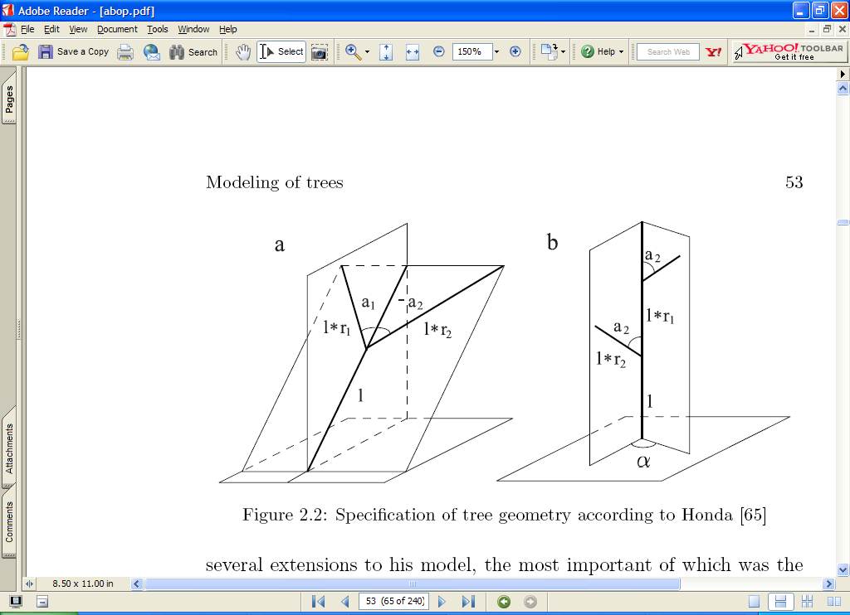
Honda’s Geometry

Slide 12
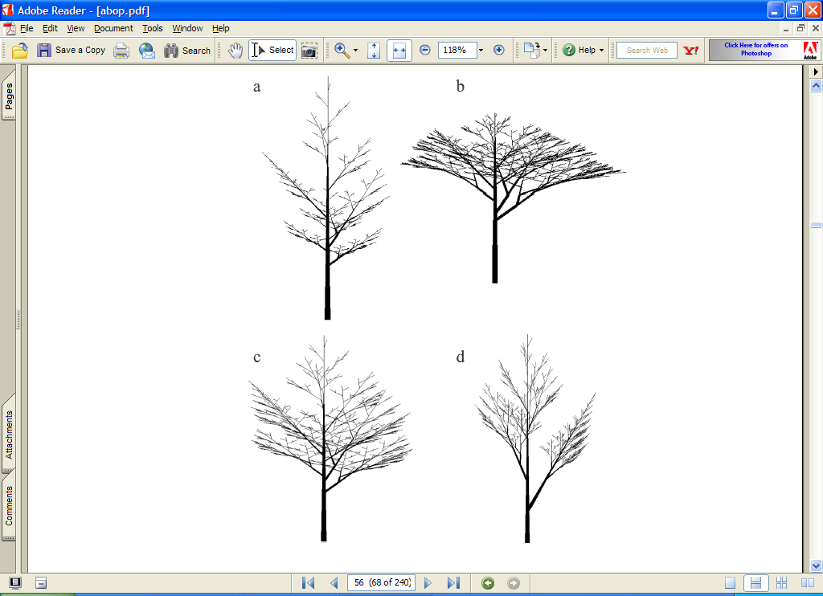
Honda’s Trees

Slide 13
Example of L system
variables : X F
constants : + − [ ]
start : X
rules : (X → F−[[X]+X]+F[+FX]−X), (F → FF)
angle : 25°
Here, F means "draw forward", − means "turn left 25°", and + means "turn right 25°". X does not correspond to any drawing action and is used to control the evolution of the curve. The square bracket "[" corresponds to saving the current values for position and angle, which are restored when the corresponding "]" is executed.

Slide 14


Slide 15
